Slide 1
Intro to Openvas
CW3 JAMES HONEYCUTT

Slide 2
About_Honeycutt
24 Years of service (21 in IT/Cyber)
Former PEC SysAdmin
169 CPT team expert for Windows and PowerShell
Howard Community College Adjunct Instructor
VP-Outreach for ISSA Central Maryland
PowerShell enthusiast

Slide 3
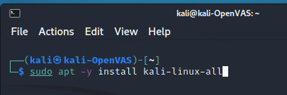
OpenVAS Install
Notes:
Attempted install of kali-linux-core
OpenVas was not part of the tool list
Attempted to install kali-linux-large

Slide 4
Features
Authenticatecd and Unauthenticated Scans
Daily updates (Has a test for Solar Winds)
Part of the commercial version of Greenbone Security Manager (GSM)
Uses Greenbone Community Feed (GCF) to update NVT (Network Vulnerability Tests)

Slide 5
GCF vs. GSF
GCF – Greenbone Community Feed
GSF – Greenbone Security Feed
Pretty much the same, except the GSF comes with some enterprise tests that GCF does not.

Slide 6
Acronyms and terminonology
NVT - Network Vunlerability Test. Scan Definitions
GVM - Greenbone Vunlerability Management
GSM - Greenbone Security Manager - Commercial Vulnerability Management
CPE - Common Platform Enumeration
Source Addtion - Open Source version of OpenVAS

Slide 7
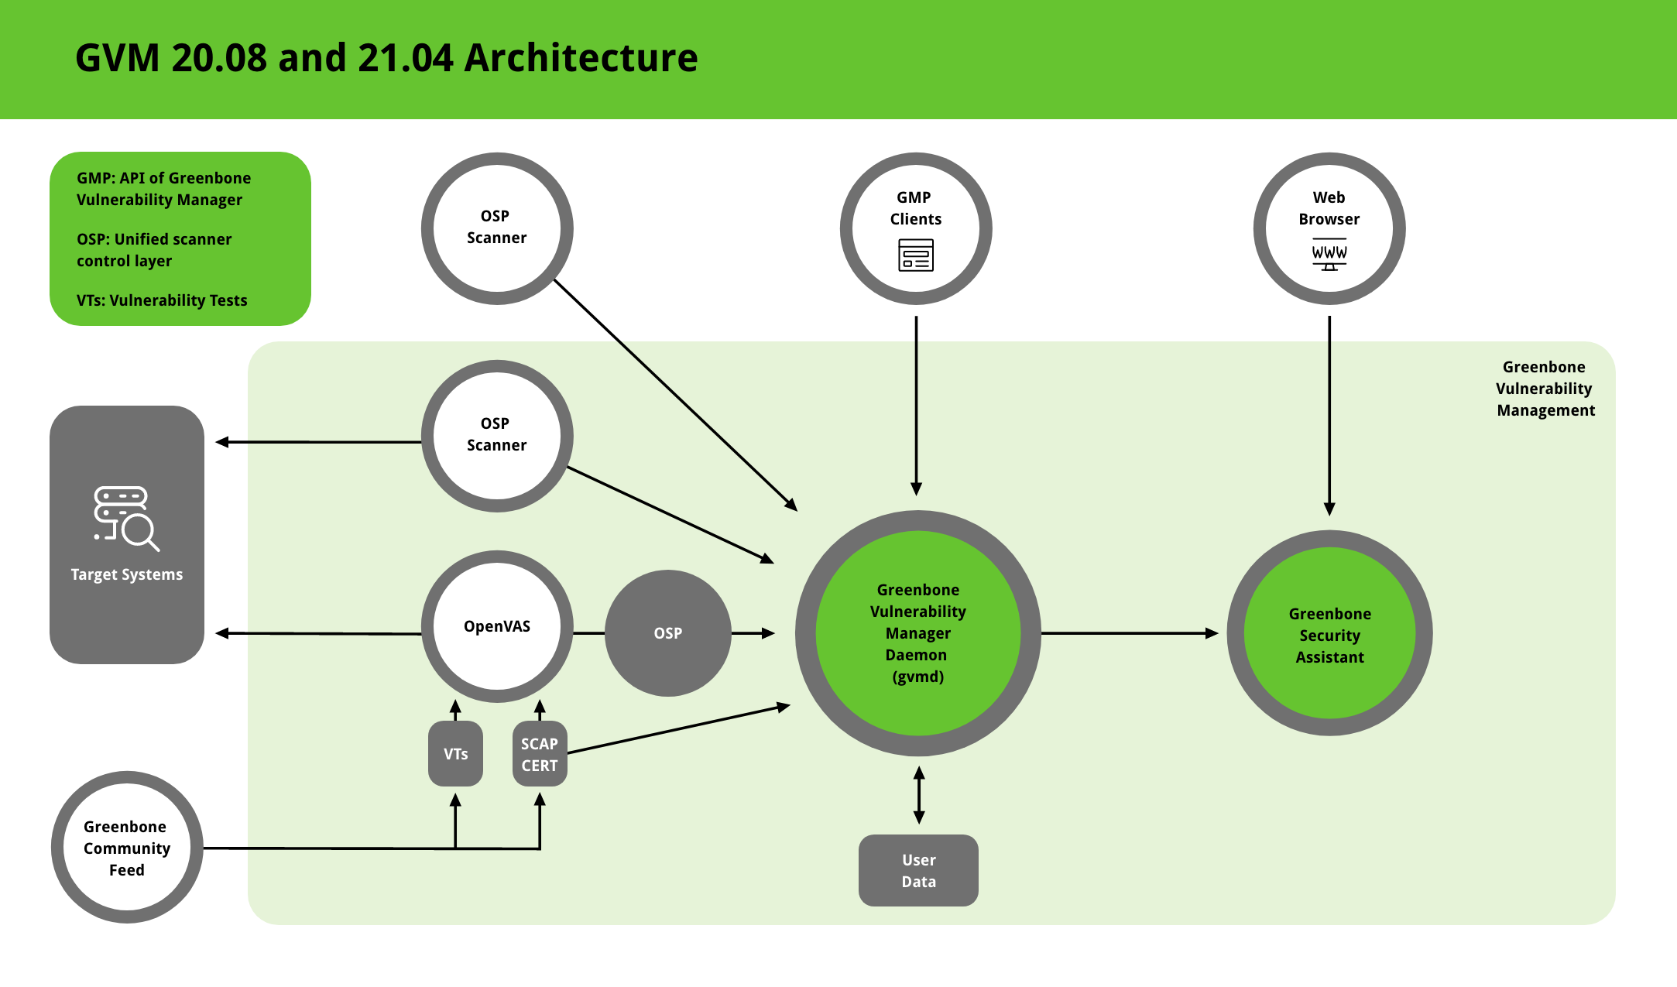
Topology Overview

Slide 8
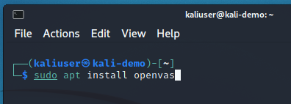
OpenVAS Install

Slide 9
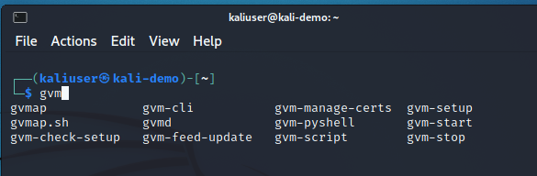
OpenVAS Install (Cont.)

Slide 10
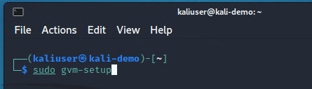
OpenVAS Install (Cont.)
Documentation Uses “OpenVAS”

Slide 11
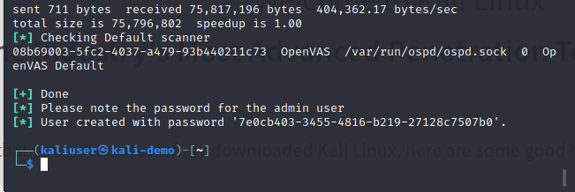
OpenVAS Install (Cont.)
Copy this for later use.

Slide 12
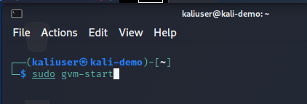
OpenVAS Install (Cont.)

Slide 13
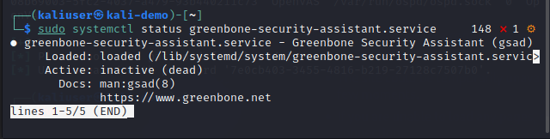
OpenVAS Install (Cont.)
Check these services

Slide 14
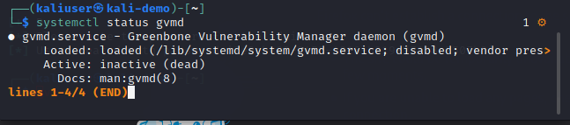
OpenVAS Install (Cont.)

Slide 15
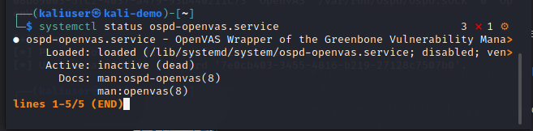
OpenVAS Install (Cont.)

Slide 16
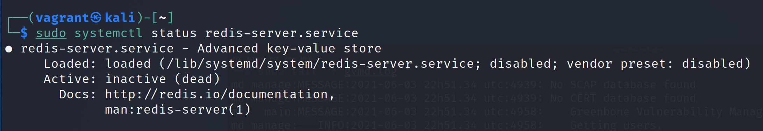
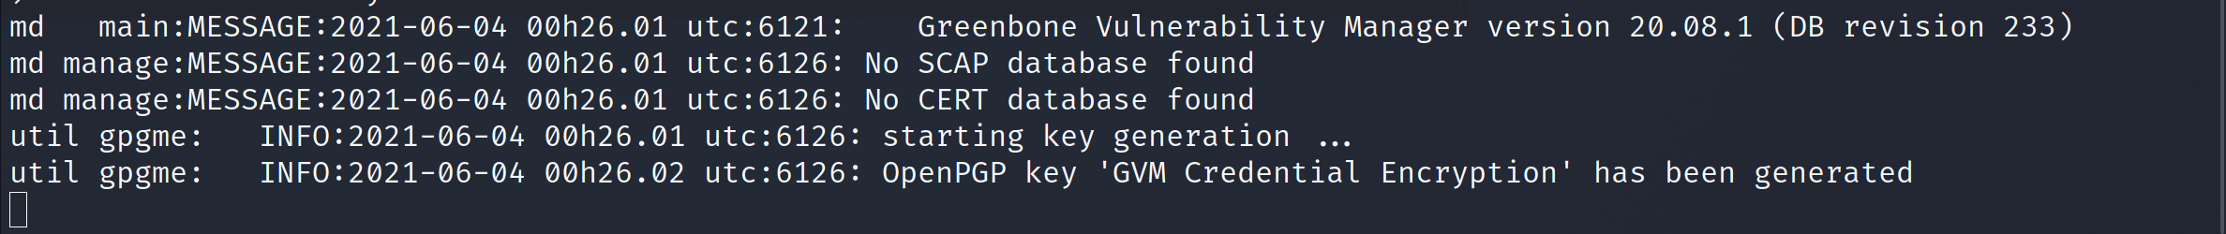
Gotchas
Check the Redis service to make sure it is still running
Double check the /var/log/gvm/gvmd.log

Slide 17
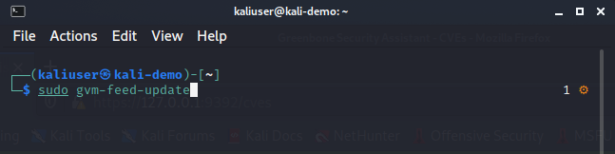
Update gvm feed

Slide 18
Gvm-feed-sync script
`sudo runuser -u _gvm -- greenbone-nvt-sync`
`sudo runuser -u _gvm -- openvas -u`
`sudo runuser -u _gvm -- greenbone-feed-sync --type GVMD_DATA`
`sudo runuser -u _gvm -- greenbone-feed-sync --type SCAP`
`sudo runuser -u _gvm -- greenbone-feed-sync --type CERT`

Slide 19
Sync Commands
`sudo runuser -u _gvm -- greenbone-nvt-sync`
`sudo runuser -u _gvm -- greenbone-certdata-sync`
`sudo runuser -u _gvm -- greenbone-scapdata-sync`

Slide 20
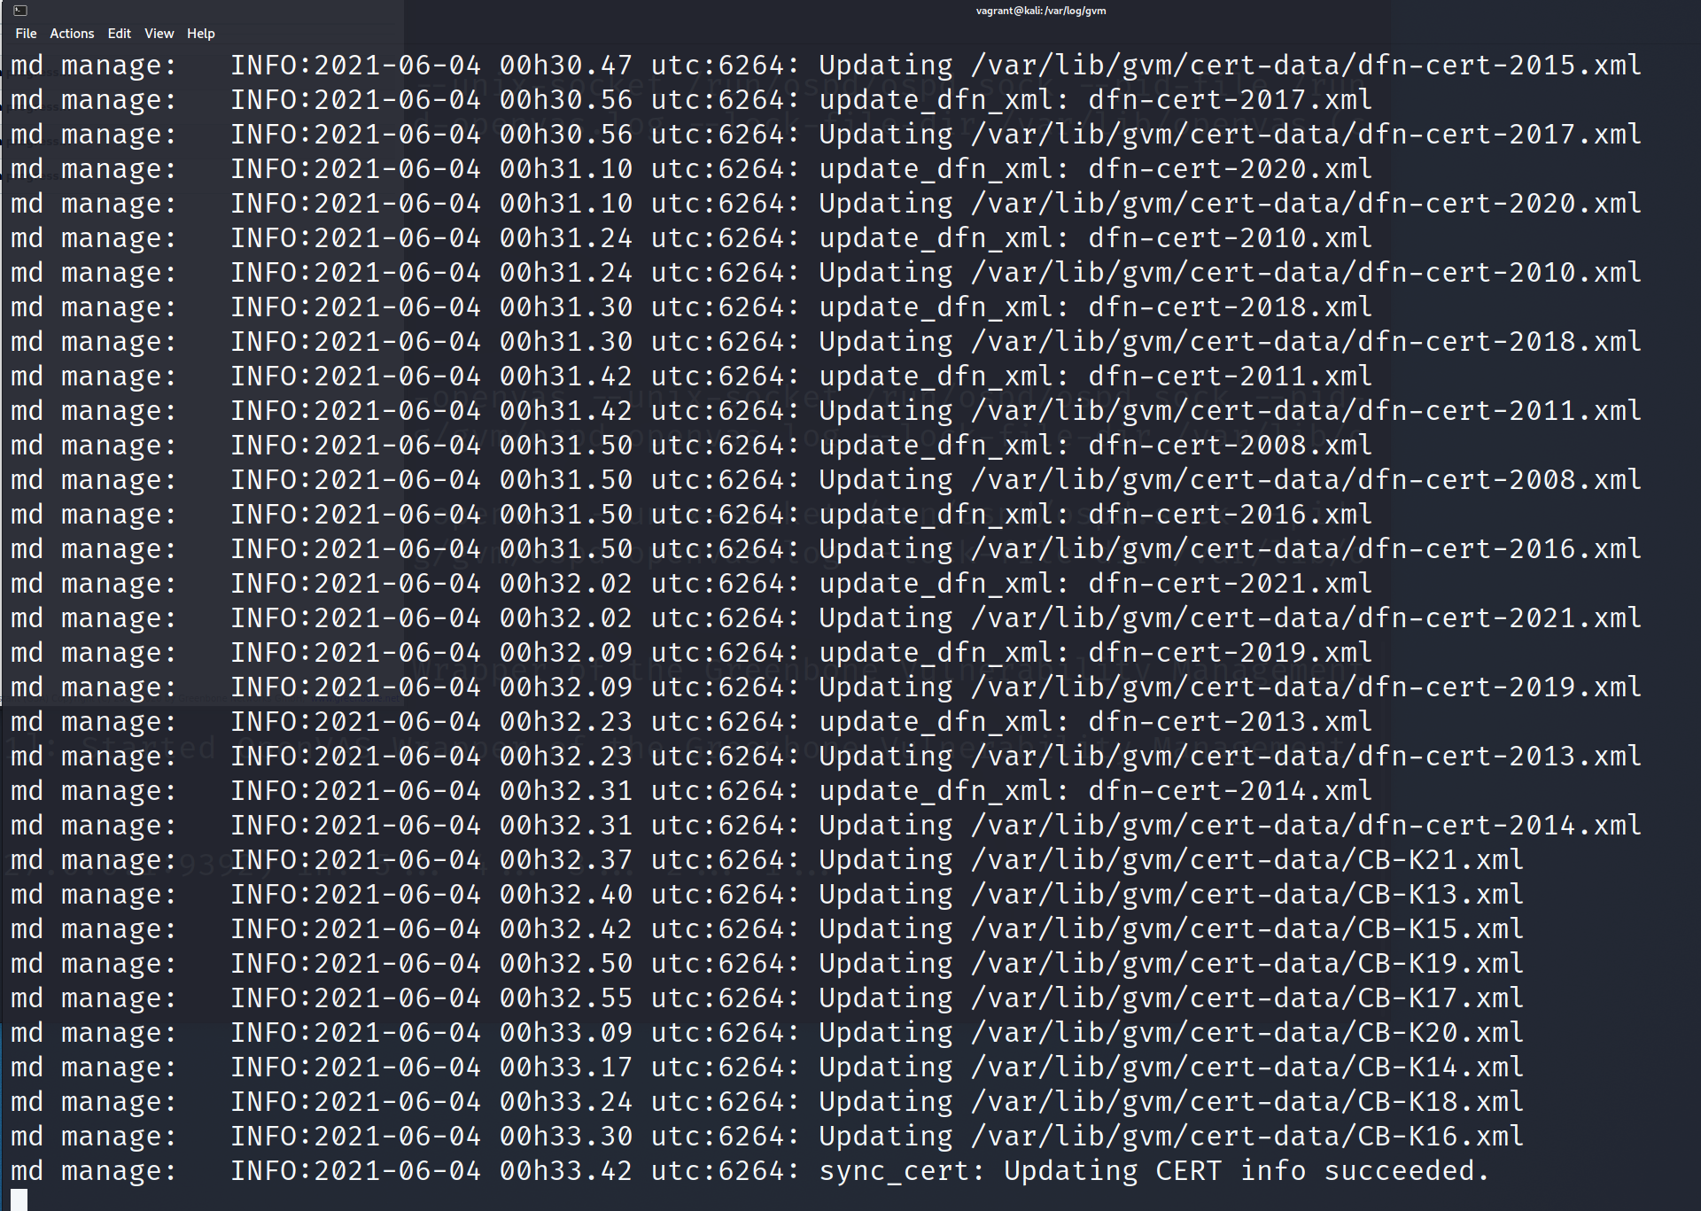
Wait until Sync is compete

Slide 21
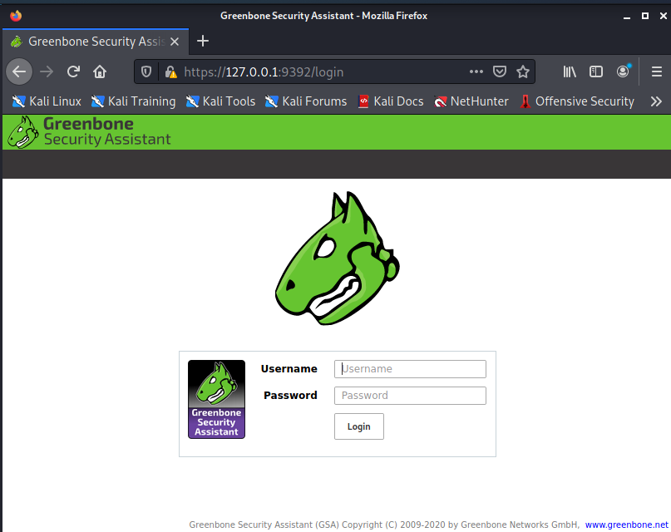

Slide 22
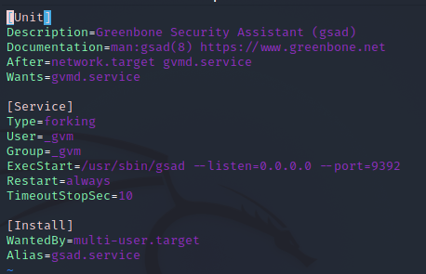
Set Web to listen on all ports
cd /lib/systemd/system
vi greenbone-security-assistant.service
Change 127.0.0.1 to 0.0.0.0

Slide 23
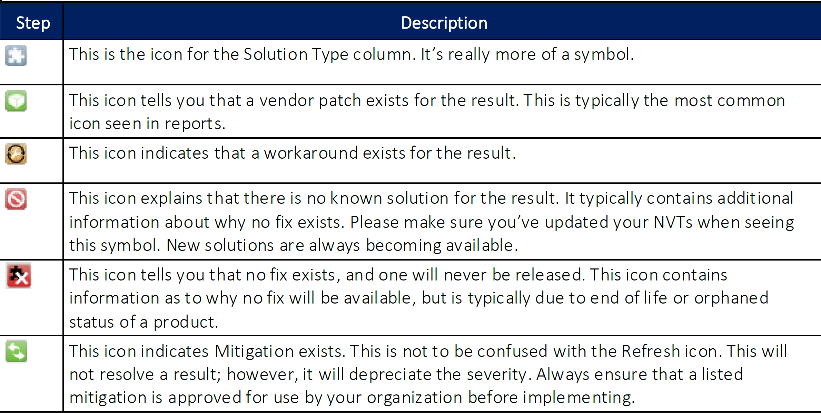
Icon overview

Slide 24
Scan demo

Slide 25

Questions?????

Slide 26
References
1. Online Admin Manual - https://docs.greenbone.net/GSM-Manual/gos-6/en/introduction.html
2. Kali Documentation - https://tools.kali.org/vulnerability-analysis/openvas
3. Kali Blog - https://www.kali.org/blog/configuring-and-tuning-openvas-in-kali-linux/

Slide 27
Follow Me
YouTube: https://www.youtube.com/c/P0w3rChi3f
GitHub: https://github.com/P0w3rChi3f
Twitter: https://twitter.com/P0w3rChi3f
LinkedIn: https://www.linkedin.com/in/james-honeycutt/

